Slide 1
Mid-Project Presentation
By Anmol Dash

Slide 2
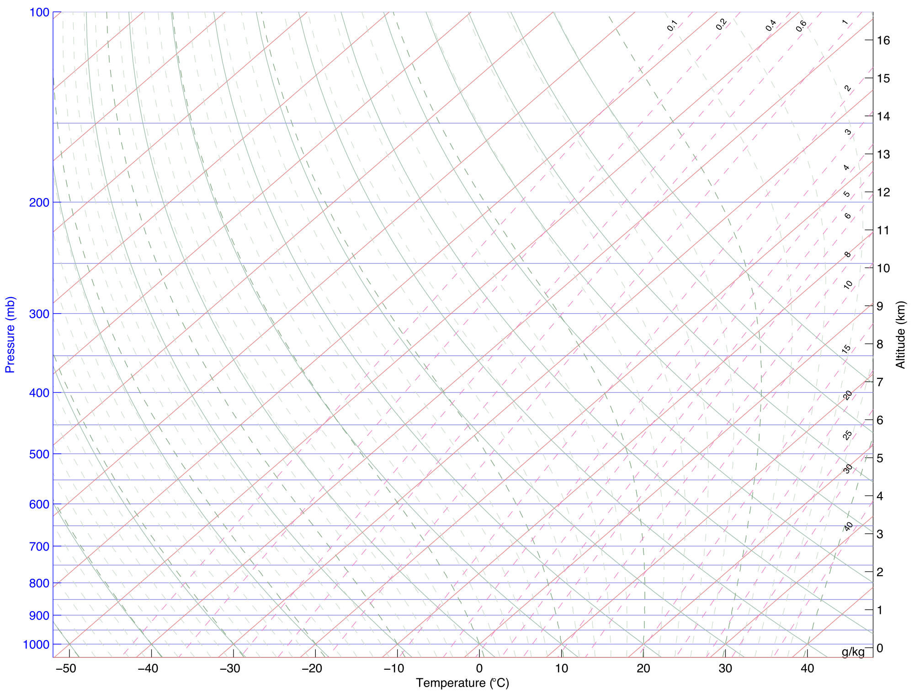
Original Goals
Create a Pytorch or LGTM model to predict CCL and LCL from thermal images
See what can be found from ASOS station data
Try to find the connection between regular images and thermal images- could we interconvert the two without the thermal data, just the dates/times? With meteorological data?
Can we find anything else from the thermal images and corresponding data?

Slide 3
What are CCL and LCL?
LCL(Lifting Condensation Level)
Requires lifting of the air parcel
Height at which the relative humidity of an air parcel reaches 100%.
Can be used to estimate the height of a cloud base
CCL(Convective Condensation Level)
Similar to LCL, though must reach critical convective temperature
Usually equal to LCL, or slightly higher
Focused on LCL

Slide 4
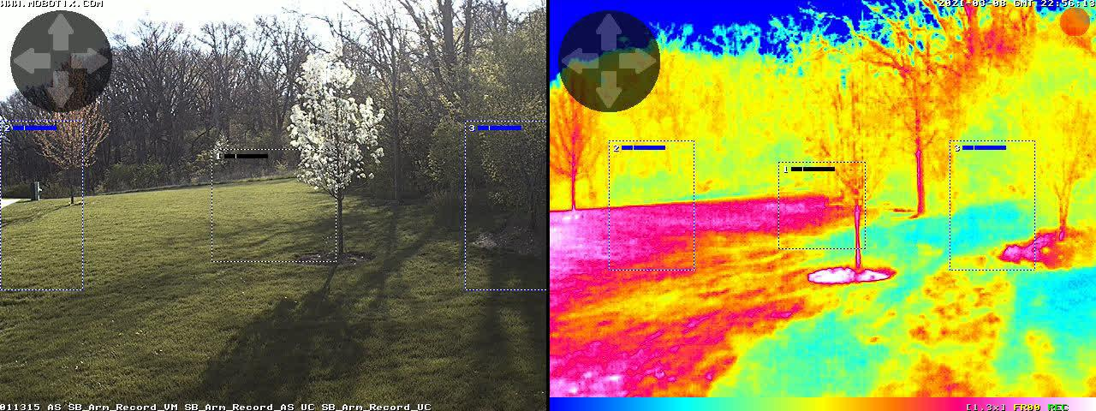
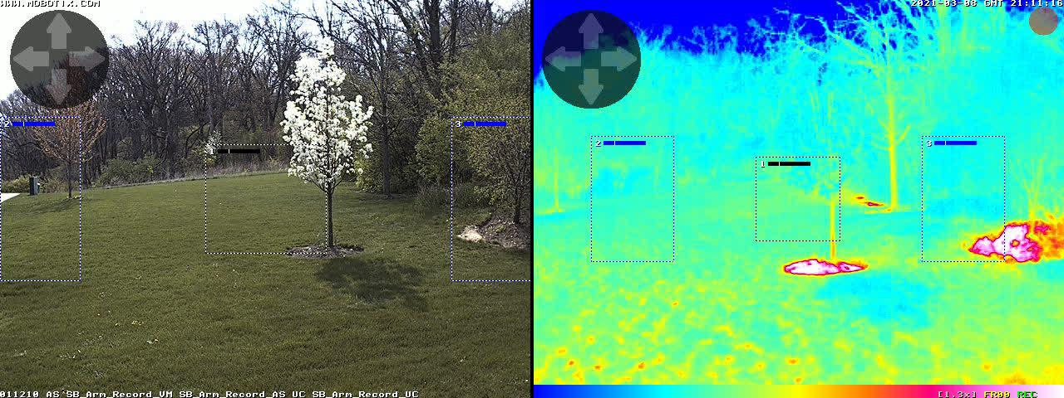
Tools that were used
ASOS(Automated Surface Observation Systems) Data
Two datasets, both taken near Argonne(O’Hare)
Larger one from 2010-2020(100k entries),
Hourly Visibility
Hourly Wind Speed and Direction
Hourly Sea Level Pressure
Relative Humidity
Hourly Wet Bulb Temperature
MOBOTIX Data
Pictures taken hourly from 4/15 to 4/25
Corresponding thermal and regular images
Corresponding temperature arrays

Slide 5


Machine Learning Techniques Used
Pytorch
Used to link the images(thermal and regular)
Used as
Tensorflow(new)
Used to link ASOS data and temperature arrays
Did not use LGTM model

Slide 6
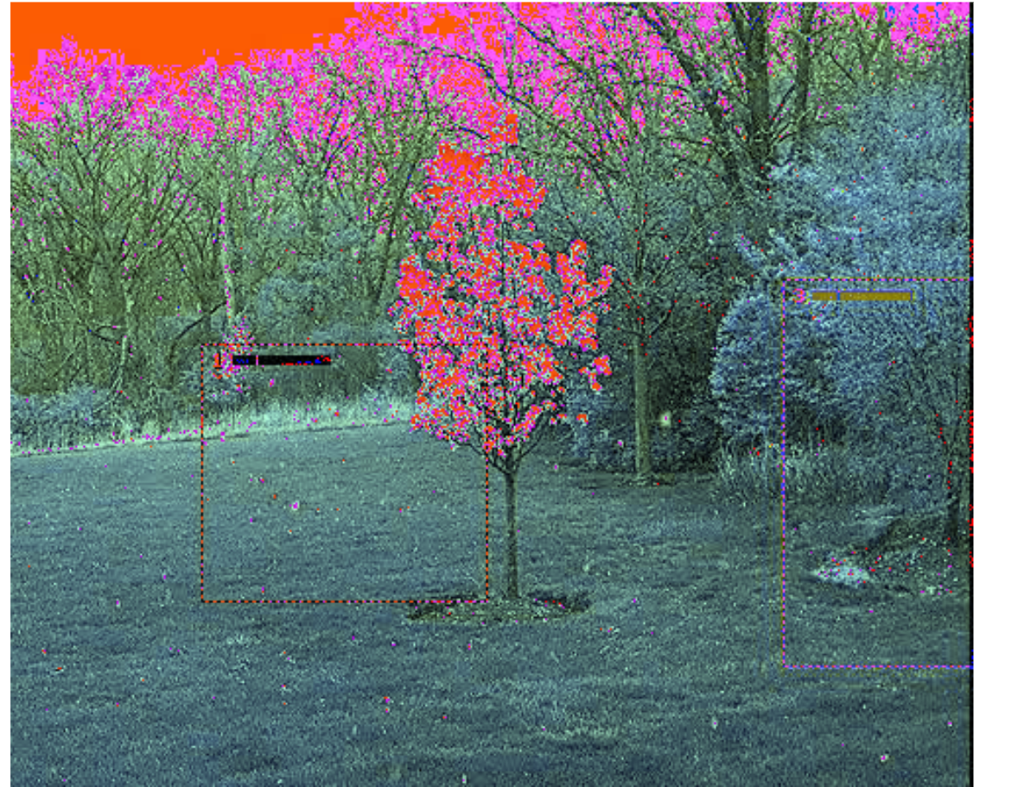
Thermal imaging link
Using date and image, tried to generate an approximation of the corresponding thermal image
Largely unsuccessful
Even with added meteorological factors, there was no correlation that could be determined
Used Pytorch

Slide 7
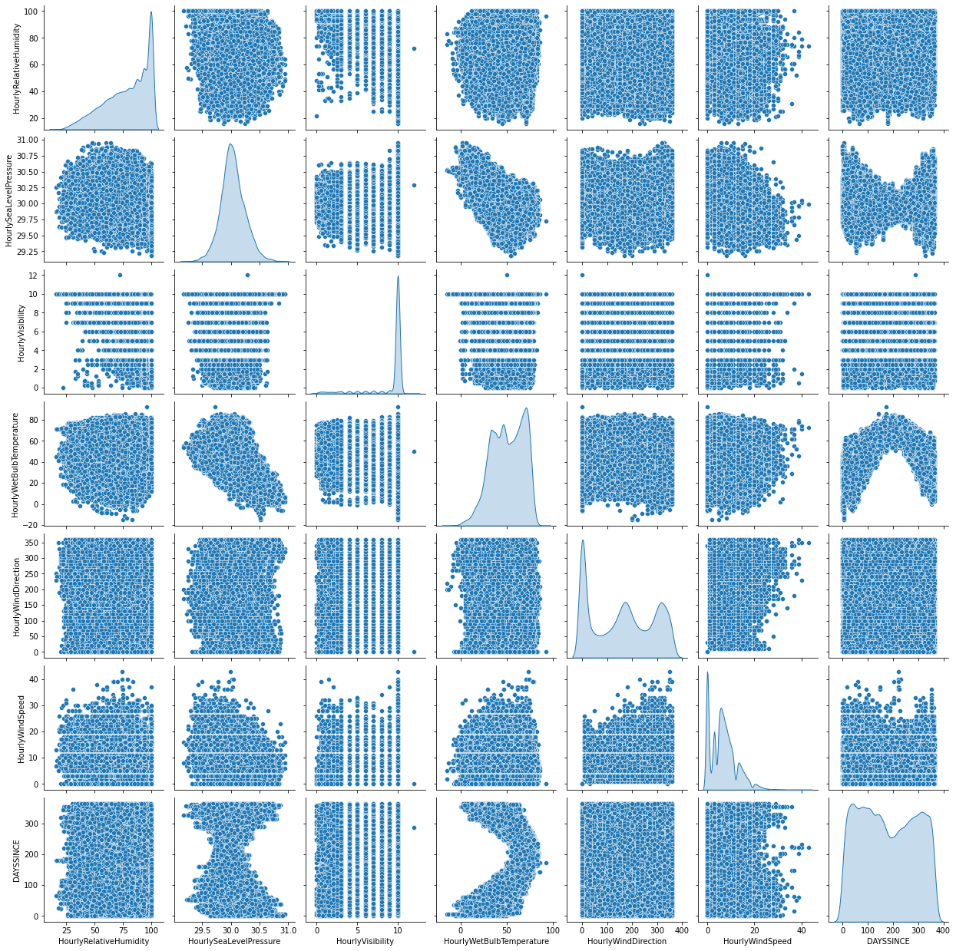
LCL Calculation
Two attempts
One for the data from 2010 to 2020
LCL Pressure and Temperature calculated from Dry Bulb Temperature, Dew Point Temp, and Station Pressure
Using Tensorflow, created a Sequential Model to predict LCL Pressure and Temperature using Wind Speed and Direction, Visibility, Humidity, Sea Level Pressure, and Wet Bulb Temperature
Model explained variance score is 95%(For LCL Temperature)
59% without humidity
84% without temperature
85% without sea level pressure
80% without wind speed and direction

Slide 8
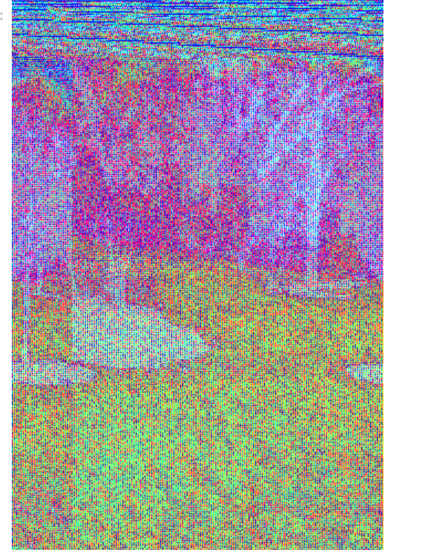
Second LCL Calculation
Created image out of thermal CSVs(over period from 4/15-4/21) this year to determine which temperatures correspond to which parts of the image
Used Keras Functional model to use thermal csv inputs
Without thermal image data, LCL Pressure cannot be calculated
Thermal image data interferes with LCL Temperature calculation(only need Sea Level Pressure, humidity,and Wet Bulb Temperature)
Specific areas of the thermal image rarely aid in calculation of LCL- whole image needed)
Accuracy for both reaches 99%

Slide 9
Next Steps
Working on creating a plugin using the model(need to upload to ECR and reformat some files)
Constructing a similar model using surface heating and thermal imaging data.
Getting irradiance data

Slide 10
Thanks for listening!

